Slide 1
Session 4
Peter Bojo

Slide 2
Points to talk about
Types of morphemes
Morphemic and Word-formation structure of lexical units

Slide 3
1. Morphemic structure of words
Words can be divided into smaller meaningful parts – morphemes
MORPHEMES – the smallest meaningful units into which a word can be divided
A word may consist of one morpheme (go, love, look) or more morphemes (lovel-ly, un-happy,

Slide 4
A morpheme can be represented by different forms (describe – description, apply – application, omit – omission). – These forms are called allomorphs
An ALLOMORPH is one of the forms of a morpheme differing from the basic form by certain sound(s) or letter(s) make-up. It is its realization

Slide 5
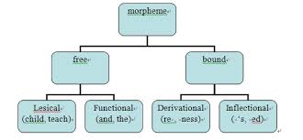
Classification of morphemes
Free – bound
Root – affixational
Lexical – grammatical

Slide 6
2.1 Free and bound morphemes
FREE MORPHEMES: morphemes homonymous with words: act(or), arm(s)
BOUND MORPHEMES: are those morphemes which are used only with other morphemes: (nice)-ly, un-(like), speak-s

Slide 7
2.2. Root and Affixational morphemes
ROOT MORPHEMES (roots): The basic common elements of words – their lexical centres within a word family. They are usually free: friend (friend-ly, friend-ship)
AFFIXATIONAL MORPHEMES: other linguistic elements attached to the root, at the beginning or at the end of it. (these are bound morphemes) – ly, un, ment
1. Prefixes 2.Sufixes 3. Infixes

Slide 8
Affixes according to their function
According to their function, affixes are divided into 1. Inflectional and 2. Derivational

Slide 9
INFLECTIONAL: used to build new forms of the word (s, ed). They are grammatical markers
DERIVATIONAL: used to build new words/lexemes (or, ive, un)
Some affixes can be both inflectional and derivational: colours (farby, zástava), customs (zvyky, clo), works (závod)

Slide 10
Morphemic analysis
We are interested in the morphemic structure, the number and types of morphemes in a word – morphemes being the basic units
According to the number of units – 1. monomorphemic words, 2. polymorphemic words
MONOMORPHEMIC WORDS – only one morpheme (one free morpheme, root) – boy, girl, man
POLYMORPHEMIC WORDS – at least one free morpheme and one bound morpheme (a root and a morpheme) – boyhood, disarm, beautifully

Slide 11
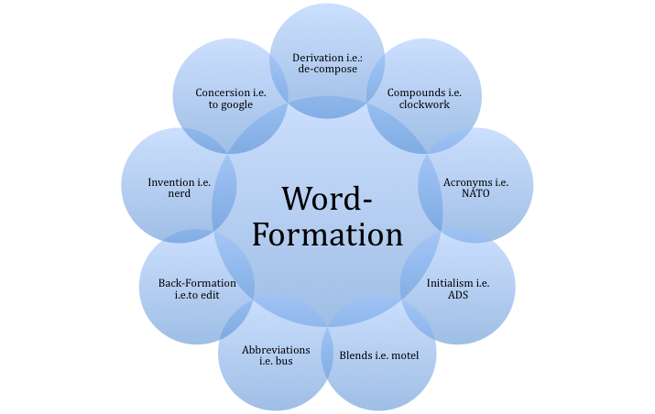
Word-formation structure of words

Slide 12
Word-formative units
On the word-formation level of analysis we are concerned with a WORD BASE (a word-formative base, stem) and DERIVATIONAL AFFIXES (word-formative elements, formants)
Word-formation analysis need not be identical with the morphemic one. Even when they coincide, they are interpreted differently... E.g.

Slide 13
While in the morphemic analysis the basic unit is a morpheme, in the word-formation analysis the basic units are a base and an affix
The BASE is the basic part of a word, consisting of one or more morphemes, from which a new word is formed and which is common to all the other forms of the word. It is the remaining part after the last affix is taken away.

Slide 14
MORPHEMIC analysis | WORD-FORMATION analysis
Work-er | Work-er
Govern-ment-al | Government-al
Act-iv-ity | Activ-ity
Un-friend-li-ness | Un-friendliness

Slide 15
PSEUDOMORPHEMES: synchronically, we sometimes have problems with identification of individual parts. We are able to identify derivational morphemes (a prefix) but have problems with identification of the base, or vice versa: en-gage, re-tain, de-ceive. These are called pseudomorphemes.

Slide 16
Types of word-formative bases
Bases
Simple complex
Child-hood
derived compound
government-al fulfil-(ment)

Slide 17
From the point of view of word-formative structure bases may be:
Simple: only one morpheme. Here the base is equal to the root, and morphemically it is non-motivated: nice(ly), child (hood)
Complex: are morphologically motivated and may be further divided into derived and compound bases:
Derived bases: one root morpheme and an affix: government(al)
Compound bases: at least two roots: sportsman(ship), fulfil(ment)

Slide 18
Morphemic and Word-formative structure - Differences
Morphemic analysis | Word-formative analysis
Root | Base (Stem)
Basic unit is morpheme | Basic units are base and affix

Slide 19
Affixes – additional comments
Affixes may be of different origin (latin (inter), French (ette), Greek: (a) comfortable)
Productive/non-productive affixes – only some affixes are frequently used to form new words. The degree of productivity varies and in general, prefixes are more productive than suffixes. Productive affixes are e.g. anti, ize, ism, ness – antiwar

Slide 20
Affixes may be polysemous, homonymous, and synonymous:
Polysemous – er – who does sth (dancer), sth that does sth: (boiler)
Homonymous (used to form both the same and different word class) – en: 1. Adj – wooden, 2. verb – strenghten,
Synonymous: e.g. or, er, ist (actor, writer, artist)

Slide 21
Possibilities of combinations of a base and affixes are limited, certain bases can be combined only with certain affixes:
Nouns + -hood, -ling, ful, less

Slide 22
Thank You
pbojo@cambridge.org
0908 614 039

