Slide 1
Session 3
Peter Bojo

Slide 2
Language classficiation
Areal classification
Genetic classification
Typological classificiation – a) Lexical typology
b) Syntactic typologly
c) Phonological typology
d) Morphological typology

Slide 3
Areal classification
Languages used by neighbouring communities, although not being genetically related, sometimes influence each other and get similar features – CONVERGENT DEVELOPMENT – they become more similar and form various language groups.
E.g. Bulgarian (Slavonic), Romanian (Romance)

Slide 4
Genetic classification
Based on historical relationship between languages
Languages evolved from a single parent language belong to the same language family
E.g. English, Italian Russian and other languages all developed from Sanskrit – a pre-historic Proto-Indo-European language.
E.g. – bhrátar (sanskrit), frater – Latin, brother (English) – a formal resenblance may be seen

Slide 5
Typological Classification
Lexical typology: based on lexical difference – 1. explicit type – express meaning of the word explicitly, 2. condensed type – basic semantic components are expressed by word-formation morphemes.
Syntactic typology: according to sentence patterns: English – SVO type, Welsh – VSO type,

Slide 6
Phonological typology – 1. consonantic – consonants prevail, 2. Vocalic – vowels prevail
Morphological typology: based on morphological structure of words: a) analytic, b) synthetic – introflectional
agglutinative
polysynthetic
Intraflectional – grammatical categories expressed by a change inside the word. E.g. Arabic – kalbun – dog, kilabun - dogs
Polysynthetic – complex word forms function as whole sentences, REDUPLICATION: Indonesian – orang – person, orang orang - people

Slide 7
Development of English
Indo-European languages
Germanic languages
Old English
Middle English
Modern English

Slide 8
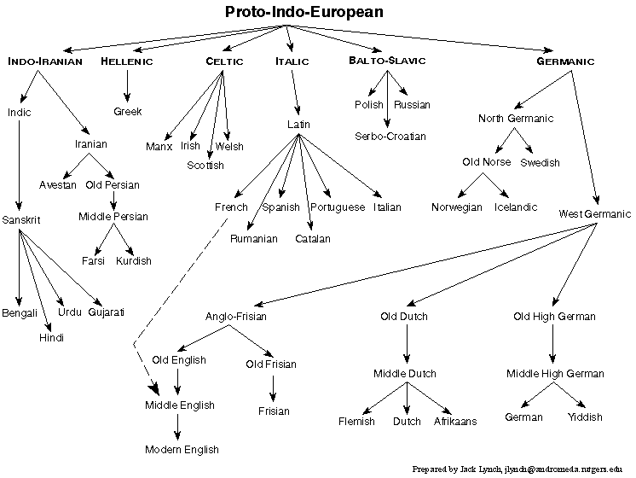
Indo-European languages
Proto-Indo-European language

Slide 9
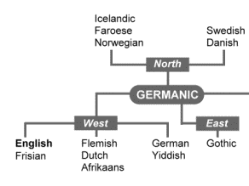
Germanic languages
Germanic languages

Slide 10
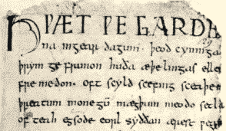
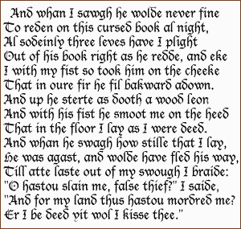
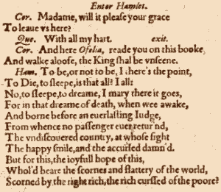
English
Part of Beowulf
Old English (4th – 11th cen)
Middle English (1100 – 1500)
Early Modern English (1500 – 1800)
Late Modern English (1800 – Present)
G. Chaucer
Hamlet by Shakespeare

Slide 11
Old English
Celtic influence – names of towns, rivers, regions (London, Avon, Kent...)
When Old Saxons started settling, Britain – still Roman province
Old Saxons controlled the country until 700
3 main Germanic tribes

Slide 12
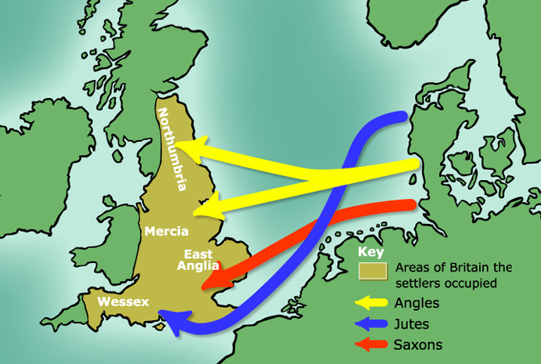
Old Saxons – North-West Germany
Angles – Denmark
Jutes – Jutland (Denmark)

Slide 13
West Saxon language – established as literary standard
Language influenced by words of Scandinavian origin: take, window, anger, knife...

Slide 14
http://www.youtube.com/watch?v=D4058Zk2Uv4
Three Rings for the Elven-kings under the sky, Seven fo the Dwarf-lords in their halls of stone, Nine for Mortal Men doomed to die, One for the Dark Lord on his dark throne In the Land of Mordor where the Shadows lie. One Ring to rule them all, One Ring to find them, One Ring to bring them all and in the darkness bind them In the Land of Mordor where the Shadows lie.
Hringas þríe þéodnum Ælfa, allra ældestum, ofer eormengrunde. Hringas seofun innan sele stænnum Dwergdryhtnum. Derc heara hús. Hringas nigon néote Moncynn, hláfordas méra mégas déaðfæge. Heolstres Hearra hring ánne weardað in dryhtsele dimmum on dercan þrymmsetle þér licgað scedwa in londe Mordores. Hring án gewalde, hring án gefinde, hring án gebringe, hring án gebinde þéoda swá þéowas in þéostrum tógedere þér licgað scedwa in londe Mordores.

Slide 15
Middle English
Battle of Hastings 1066 – native English aristocracy destroyed
French – language of ruling class
English preserved its Germanic structure
13th Century – tendency of English Population to return to English

Slide 16
1362 – English was made the official language of the law-courts
East Midland region dialect – new language standard of the country
Grammar – two inflectional systems – Old English, Old Norse
Number of noun cases reduced to 3 (Nominative, Genitive, Accusative)

Slide 17
Gramaticalisation of the sentence word order (SVO)

Slide 18
Modern English
Around 1700 – Latin still had prestige
Bible translated into English – English got the prestige
Latin still spoken by scholar and highly educated people
Modern English – changes (grammar + vocabulary)

Slide 19
Changes in Grammar and Vocabulary
en plural – replaced by –eth
3rd p.sin- eth morpheme replaced by –es ending – later - /-s/, /-z/, /iz/ allomorphs
Difference between sin. and pl. past forms disappeared
The perfective aspect was used with auxiliaries be and have
ALLOMORPH: Any of the variant forms of a morpheme. For example, the phonetic (s) of cats (k ts), (z) of pigs (p gz), and ( z) horses (hôr s z) are allomorphs of the English plural morpheme.

Slide 20
Changes in pronunciation
Great Vowel Shift – long English vowels became diphtongs or were raised
New consonant phonemes - /ŋ/ - no more a mere allophone of /n/ phoneme, /ʒ/ phoneme developed from /zj/
/k/ and /w/ still pronounced in words like knight and write
/x/ still pronounced in words like daughter and rough
/w/ dropped in the pronunciation before some back rounded vowels (sword, who...etc)
Its vowel backness is back, which means the tongue is positioned as far back as possible in the mouth without creating a constriction that would be classified as a consonant.
Its roundedness is protruded, which means that the corners of the lips are drawn together, and the inner surfaces exposed.

Slide 21
Other changes
/r/ sound disappeared before a pause or a consonant – (18th Cen, non-rhotic varieties – New Zealand, South Africa...)
Disappearance of /r/ sound caused the lengthening of previous vowel – arm /ɑːm/
/r/ sound was preserved in Rhotic varieties (e.g. North American English) - /ɑːrm/

Slide 22
18th Century – scientific progress
Many new words coined
Giving the existing forms new meaning (e.g. physics – power)
Borrowing words from other languages (Greek – larynx, Latin – vertebra, Greek – barometer)

Slide 23
Our Father...

Slide 25
Thank You! pbojo@cambridge.org

